Slide 1




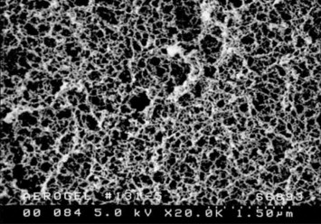

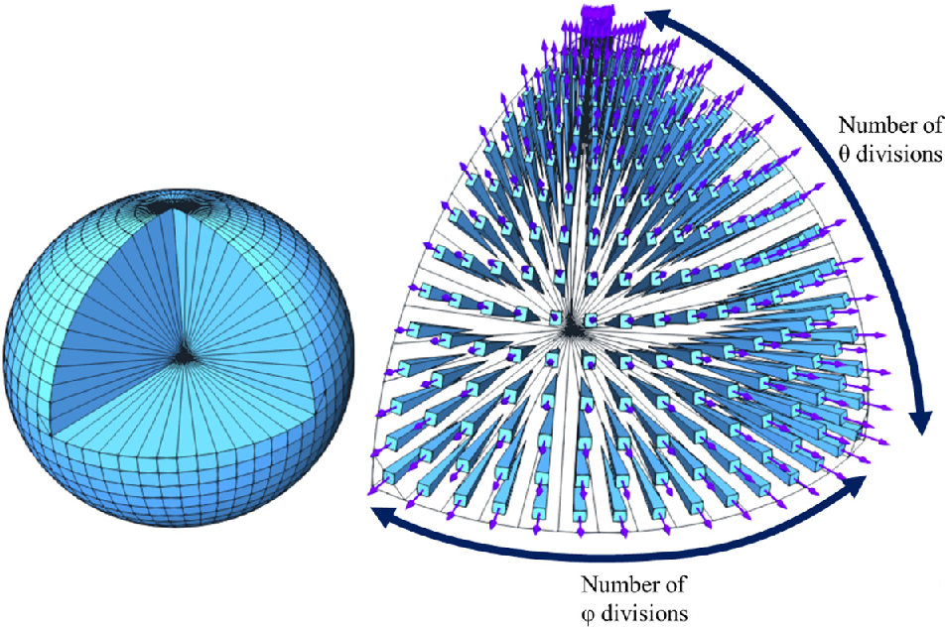
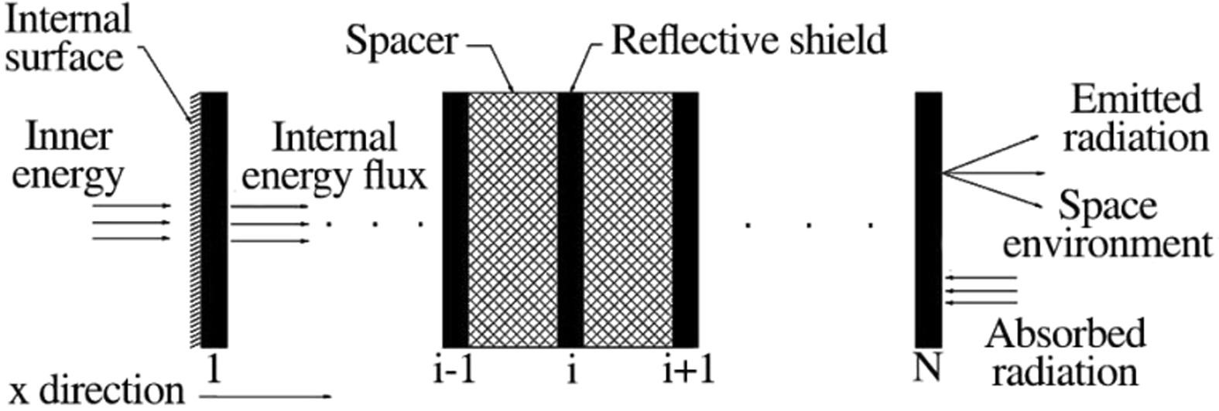
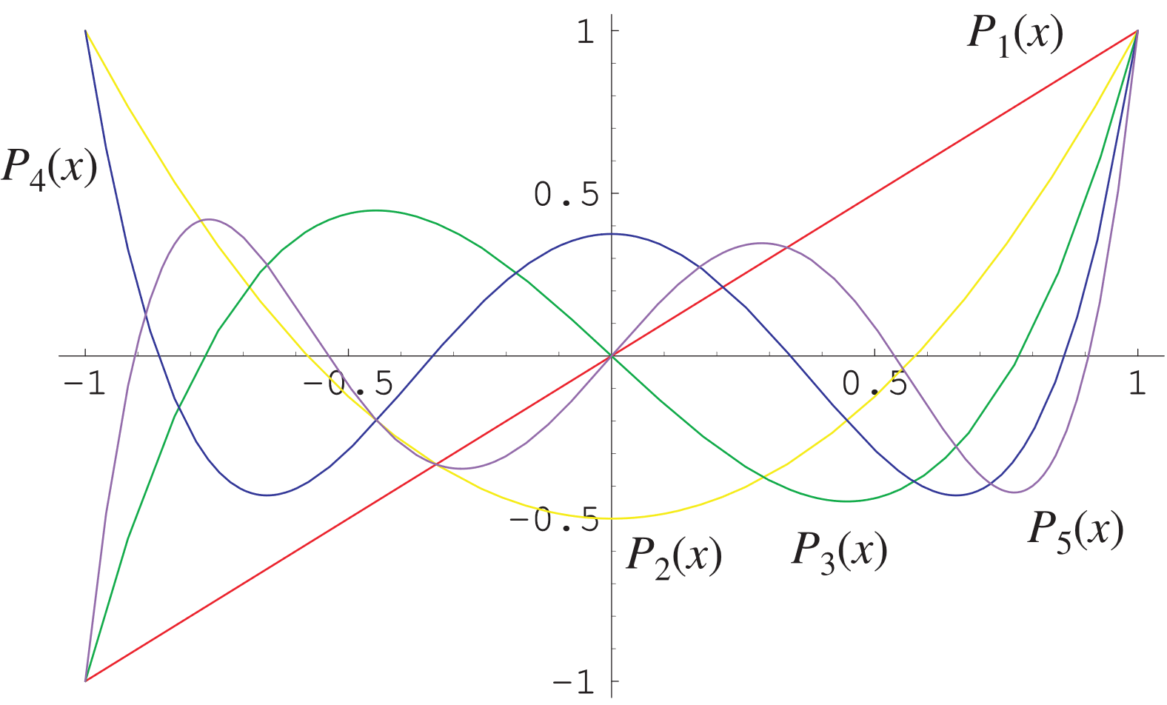
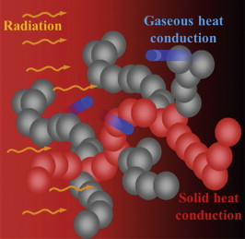

Numerical Methods for Assessing the Thermal Conductivity Performance of Aerogel Using the Boltzmann Transport Equation
Ethan Peters
^{Urmi Duttagupta PhD}1^{, Swati Neogi PhD2, Yash Verma}
Affiliations: New York City College of Technology, India Institute of Technology, Kharagpur
Abstract
Space is a domain of temperature and radiation extremes, and to this end multi-layer insulation applications (MLI) are crucial for protecting vital components on satellites. Aerogel has emerged as an ideal material for insulation design due to its low thermal conductivity, therefore the effective modeling of aerogel conduction has been a key area of research. Aerogel is a nonporous structure that does not adhere to Fourier’s Law of heat transfer. Instead, the Boltzmann transport equation (BTE) is essential to effectively model heat transfer. This project focused on developing a numerical method of solving the BTE to model the effects of aerogel in different MLI configurations. The Gaussian quadrature method was implemented to solve the BTE in different directions to account for the change in phonon energy density (Hamian, Yamada, Faghri, & Park, 2015).
FIG 5. Boltzmann Transport Equation simplified with gray relaxation time approximation
Background
Multi layer insulation finds applications in satellites to protect the inner components from the extreme temperature variations. This passive insulation method is built of repeated layers of materials that act as radiations shields and spacers.
FIG 3. Scanning electron micrograph of silica aerogel network ((He & Xie, 2015).
Methods
To model heat transfer through aerogel a numerical solution to the Boltzmann Transport Equation in a spherical domain constructed using Gaussian Quadrature method and finite element analysis (FEM) (Hamian, S., Yamada, T., Faghri, M., & Park, K, 2015). The Gaussian Quadrature method provides a fast, accurate method for performing numerical integration over the domain [-1,1]. By evaluating an interpolated polynomial at specific quadrature points, the Gaussian Quadrature method calculates the definite integral exactly up to desired polynomial degree by applying specified weights to each point.
FIG 6. Discrete Ordinate Method for spherical domain (Moreno-SanSegundo et al., 2021)
Future Work
The weights for different divisions and angles in the spherical domain can be determined. The next step in creating a numerical model is to apply this method to each node in networked mesh of the 2D filament. Finite element analysis will be utilized to perform this. Building this simulation in Python continues to be a challenging task, but open-source methods of performing FEM exist and are being pursued.
FIG 1. Structure of Multi Layer Insulation(Mesforoush et al., 2019)
Aerogel is a lightweight, nanoscale material noteworthy for its incredible thermal properties including its ability to withstand high temperatures and function as a strong thermal insulator (He & Xie, 2015). As a result of the nanoporous structure of aerogel, Fourier heat transfer does not accurately model the thermal conductivity (He & Xie, 2015). MLI is also necessary for aerogel insulation applications because aerogel has low strength. Ceramic fiber, silica fiber, and mullite fiber are often used to reinforce the strength of aerogel.
References
He, Y.-L., & Xie, T. (2015). Advances of thermal conductivity models of nanoscale silica aerogel insulation material. Applied Thermal Engineering, 81, 28-50. https://doi.org/10.1016/j.applthermaleng.2015.02.013
MathWorld. (n.d.). Legendre Polynomial. Retrieved from https://mathworld.wolfram.com/LegendrePolynomial.html
Mesforoush, H., Pakmanesh, M. R., Esfandiary, H., Asghari, S., & Baniasadi, E. (2019). Experimental and numerical analyses of thermal performance of a thin-film multi-layer insulation for satellite application. Cryogenics, 102, 77-84. https://doi.org/10.1016/j.cryogenics.2019.07.005
Moreno-SanSegundo, J., Casado, C., Concha, D., Montemayor, A.S., & Marugán, J. (2021). Optimization and parallelization of the discrete ordinate method for radiation transport simulation in OpenFOAM: Hierarchical combination of shared and distributed memory approaches. Open Research Europe, 1.
Hamian, S., Yamada, T., Faghri, M., & Park, K. (2015). Finite element analysis of transient ballistic–diffusive phonon heat transport in two-dimensional domains. International Journal of Heat and Mass Transfer, 80, 781–788. https://doi.org/10.1016/j.ijheatmasstransfer.2014.09.073
FIG 4. Legendre Polynomials, note all roots fall between [-1,1] (MathWorld. (n.d.). )
Solving the BTE becomes finding the weights of the Gaussian quadrature such the sum of all weights is equal to two pi. From this, simulating heat transfer across a 2D filament can be done using FEM where each points is updated using the discretization. An outline of finding the associated weights in Python is available as a Quarto notebook.
FIG 2. Different heat transfer modes inside aerogel (He & Xie, 2015)
This research project was supported NSF DUE Grant #1930437 Profs. Urmi Duttagupta, Diana Samaroo, Nadia Kennedy, Viviana Acquaviva, & Armando Solis . The statements contained within the poster are not the opinions of the funding agency or the U.S. government but reflect the author’s opinions.

